Slide 1

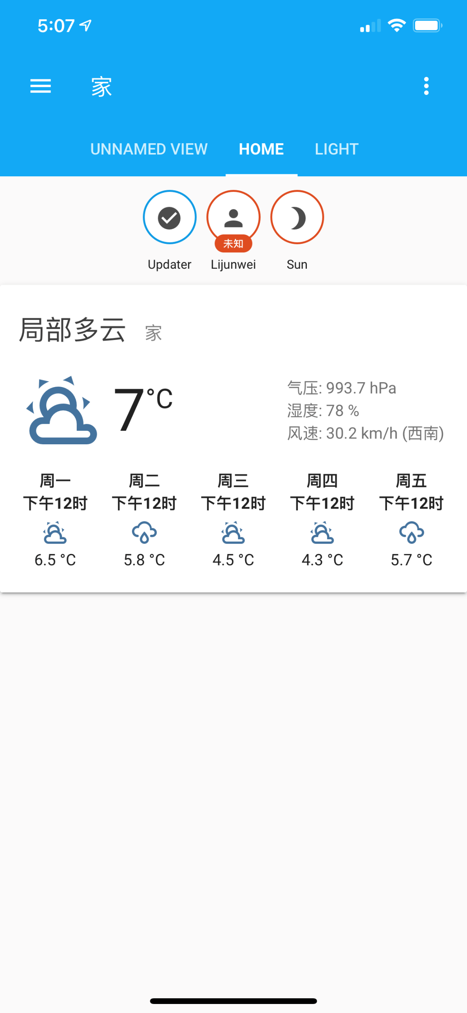
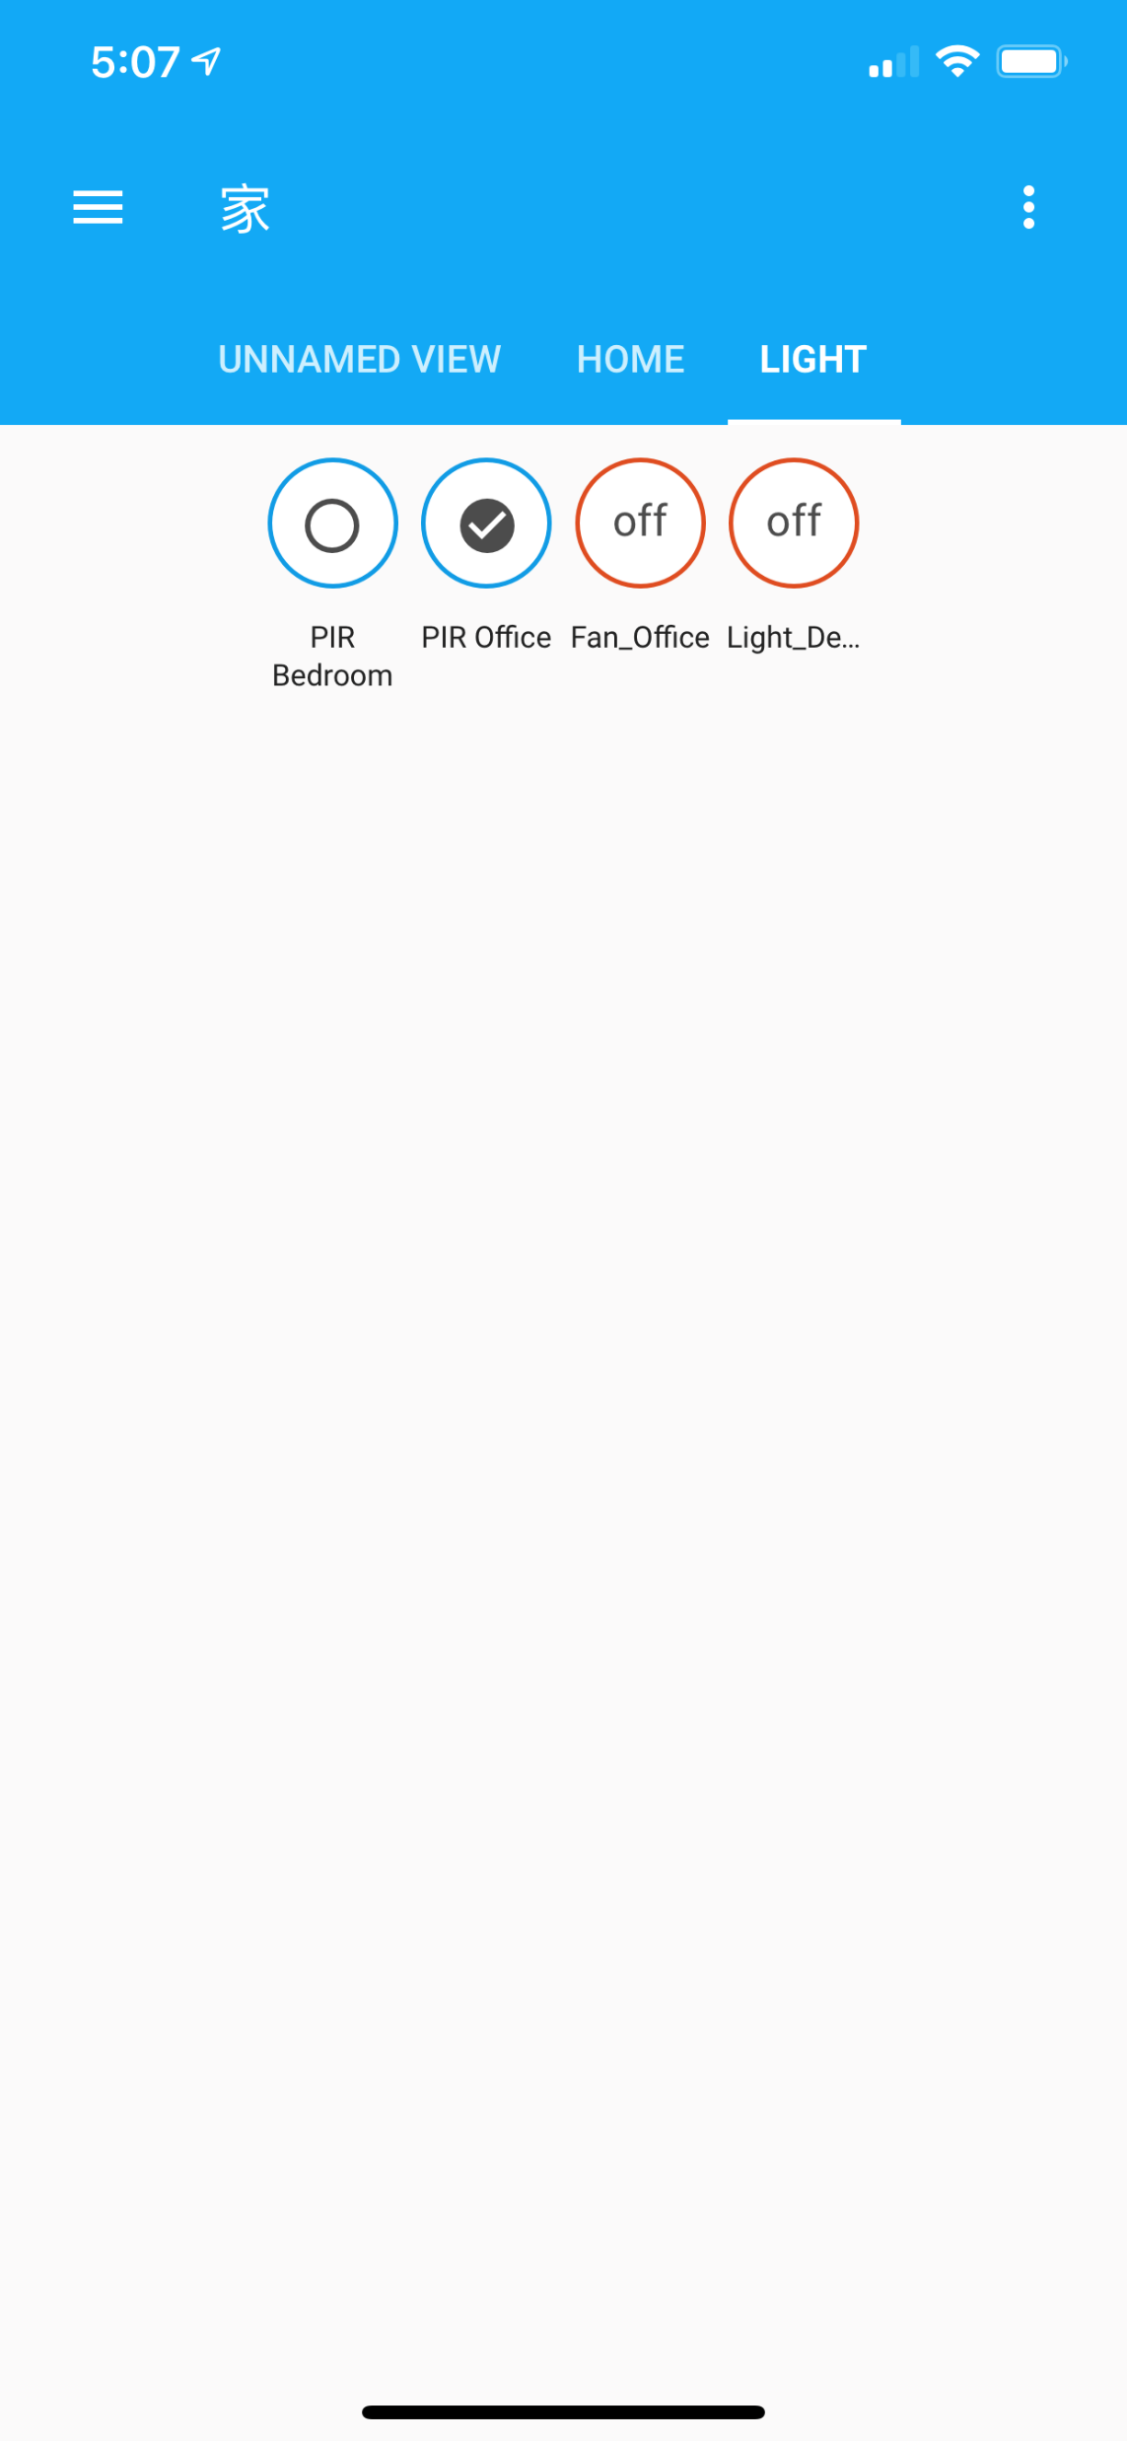
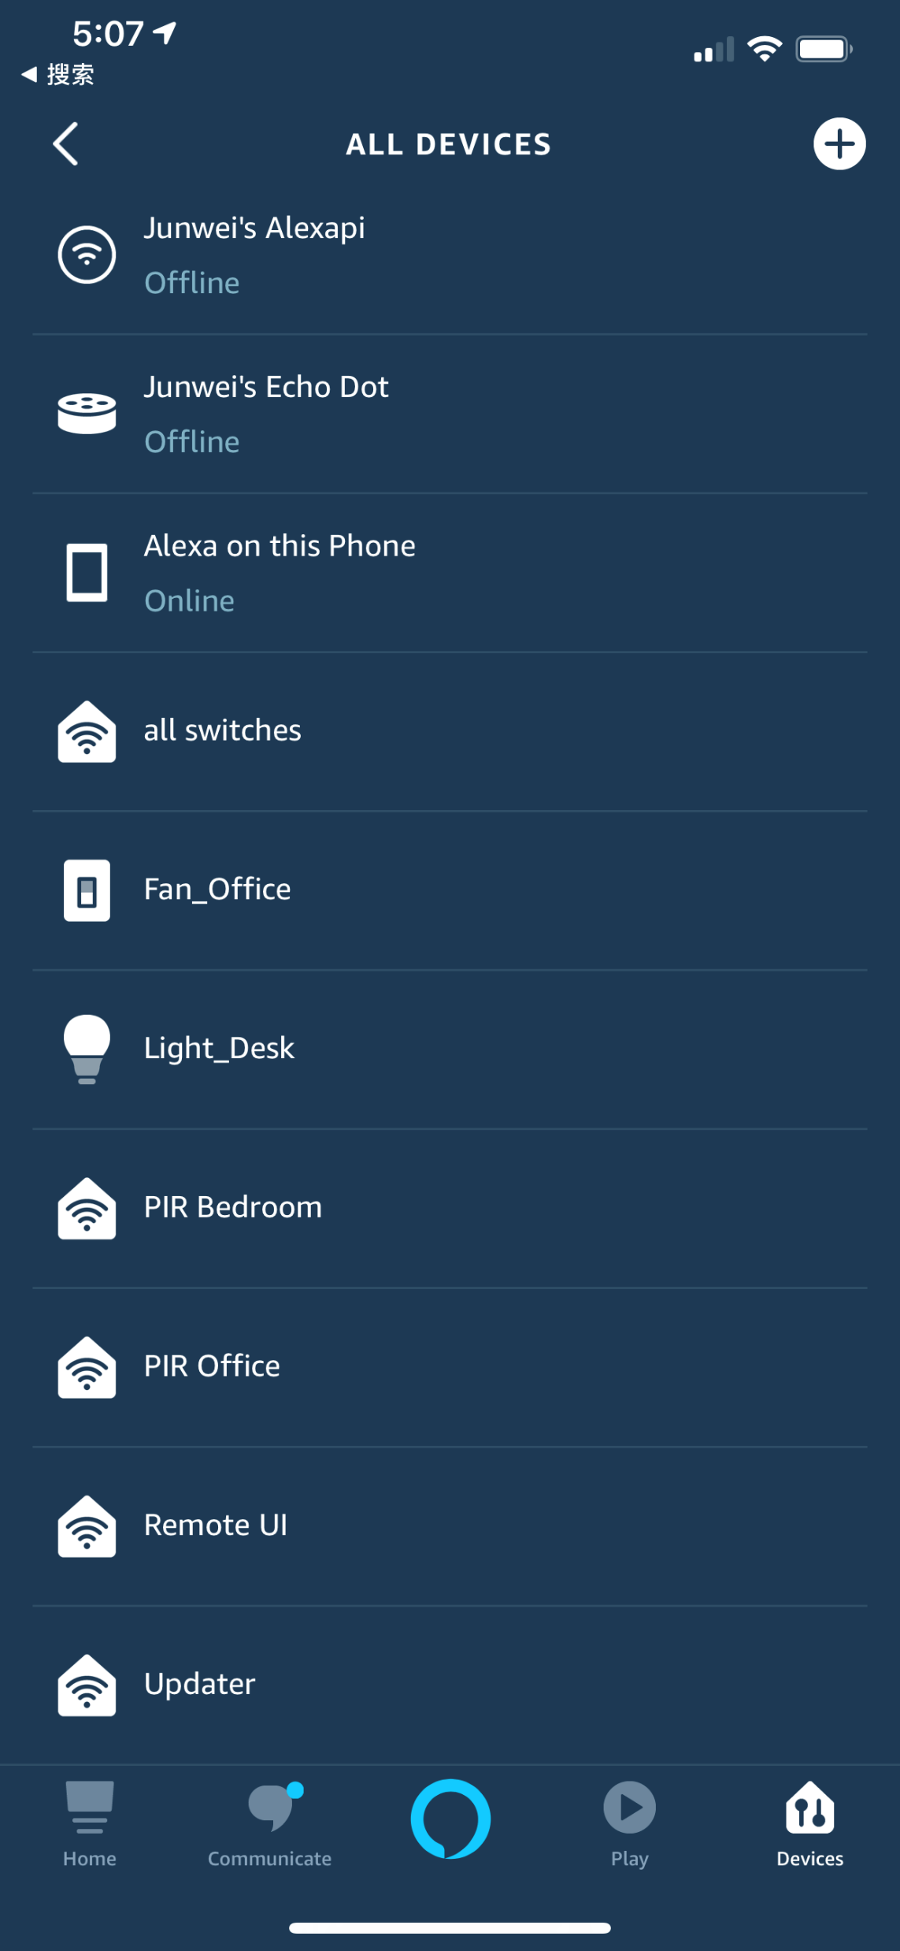




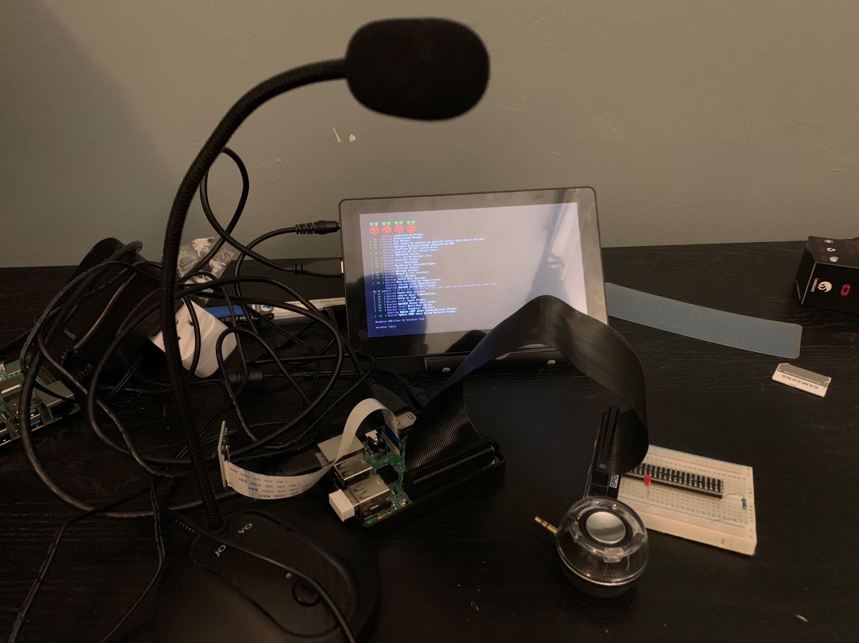













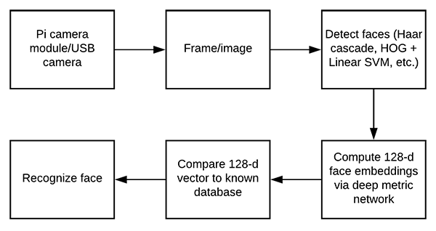



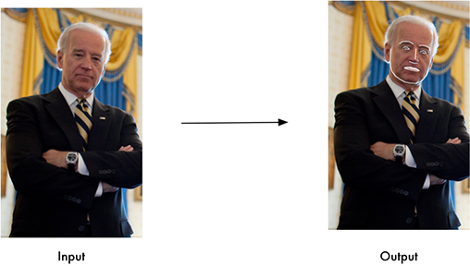
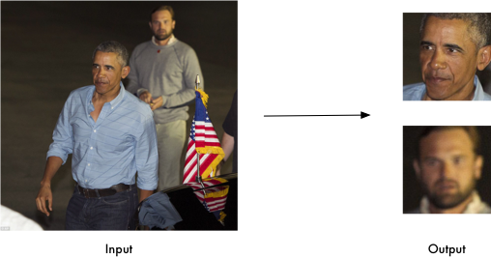
Automatic Home System
Li Junwei, Li Jingyi
Project Concept
Demonstration Picture
Concept Diagram
Open air conditioner before arrive home
What is pet doing now
Traditional Method Control
Unknow person
in your home now
Physical Button Switch
RF Remote Control
Control Home Device
Stranger.png
My wife forgets bring key !
Smart phone → website → Home assistant Cloud → Home Router → Raspberry pi server → Device
Smart phone → Alexa app → Amazon Voice Cloud → Home Assistant Cloud →Home router → Raspberry pi server → Device
Raspberry pi Alexa → Amazon Voice Cloud → Home router → Raspberry pi server → Device
Smart device(home network) → Home router → Raspberry pi server → Device
Home Assistant Cloud
All Home Device
Voice Control,
internet remote control
Good night
Voice interact with device
More convenient
Home security and real-time monitor home.
Amazon Voice service
Internet
Face Recognition
Conclusion
System Diagram
Theory Diagram
Project Evaluation
In conclusion, our project based on Home Assistant and Amazon Alexa provide a relatively simple idea that to implement remote control and voice control. Project concept shows just general idea. In our real implementation, we just used Led replaces all home devices. Regarding time constraint(about 2 months) and knowledge constraint (basically know python, raspberry pi and C++), our project has satisfied our original requirements.
WIFI Router
Internet
Power Supply
Alexa Pi
Microphone
Sample Result
Raspberry Pi 3B
Security Issues
Home Assistant Cloud
Web server
Screen
Speaker
Challenge : By now, controlling devices out of home, we need to send the command signal via Amazon Cloud or Home Assistant Cloud. We use username and password to login access could service.
Optional Solution: write a script in raspberry pi sever, certificate with Mac address and message certification.
Amazon Voice Service
Raspberry Pi 3B
LED

